Slide 1

Multimodal Emotion Recognition
School of Computer Science and Engineering
Department of Computer Science and Engineering
Submitted By: Sanya Goyal
23FE10CSE00684
Supervised By: Dr. Virendra Meghwal

Slide 2
Outline
Introduction
Literature Review
Problem Statement
Proposed Solution
Objectives
Results

Slide 3
Introduction
Emotion recognition is a cornerstone problem in affective computing, with applications ranging from human-computer interaction to mental health monitoring. Unimodal models, which rely on a single source of information like text or speech, often fall short in real-world scenarios because human emotions are complex and expressed concurrently through multiple channels—words, voice tone, and facial expressions. To address this, our project develops a multimodal emotion analysis system using the Multimodal EmotionLines Dataset (MELD), which enables the analysis of realistic, multi-party conversations.

Slide 4
Literature Review
Author / Year | Modality | Method | Key Contribution
Poria et al. (2019) | Multimodal | Baseline Models | Introduced the MELD dataset, establishing benchmark baselines.
Satt et al. (2017) | Audio | CNN-BiLSTM | Effective spectral-temporal modeling of speech emotion.
Devlin et al. (2019) | Text | BERT | Revolutionized NLP with deep contextualized embeddings.
Yoon et al. (2023) | Audio | Wav2Vec 2.0 | Advanced audio emotion recognition using self-supervised learning.
Lian et al. (2021) | Multimodal | Context-Aware Attention | Dynamic fusion for adaptive modality weighting.

Slide 5
Problem Statement
To design and implement a multimodal deep learning system for emotion recognition using the MELD dataset by integrating textual LSTM features, and acoustic CNN-BiLSTM features.

Slide 6
Objectives
Implement a text-based LSTM classifier.
Build an acoustic CNN-BiLSTM model using Mel-spectrograms.
Analyze unimodal performance.
Establish a framework for future multimodal fusion.

Slide 7
Proposed Methodology
Our approach implements a modular, multimodal framework. We process each modality independently: an LSTM network analyzes textual sequences using GloVe embeddings, while a CNN-BiLSTM architecture extracts features from audio Mel-spectrograms.
Finally, a late fusion strategy will be employed to integrate the predictions from both the streams, leveraging their complementary strengths for robust emotion classification.

Slide 8
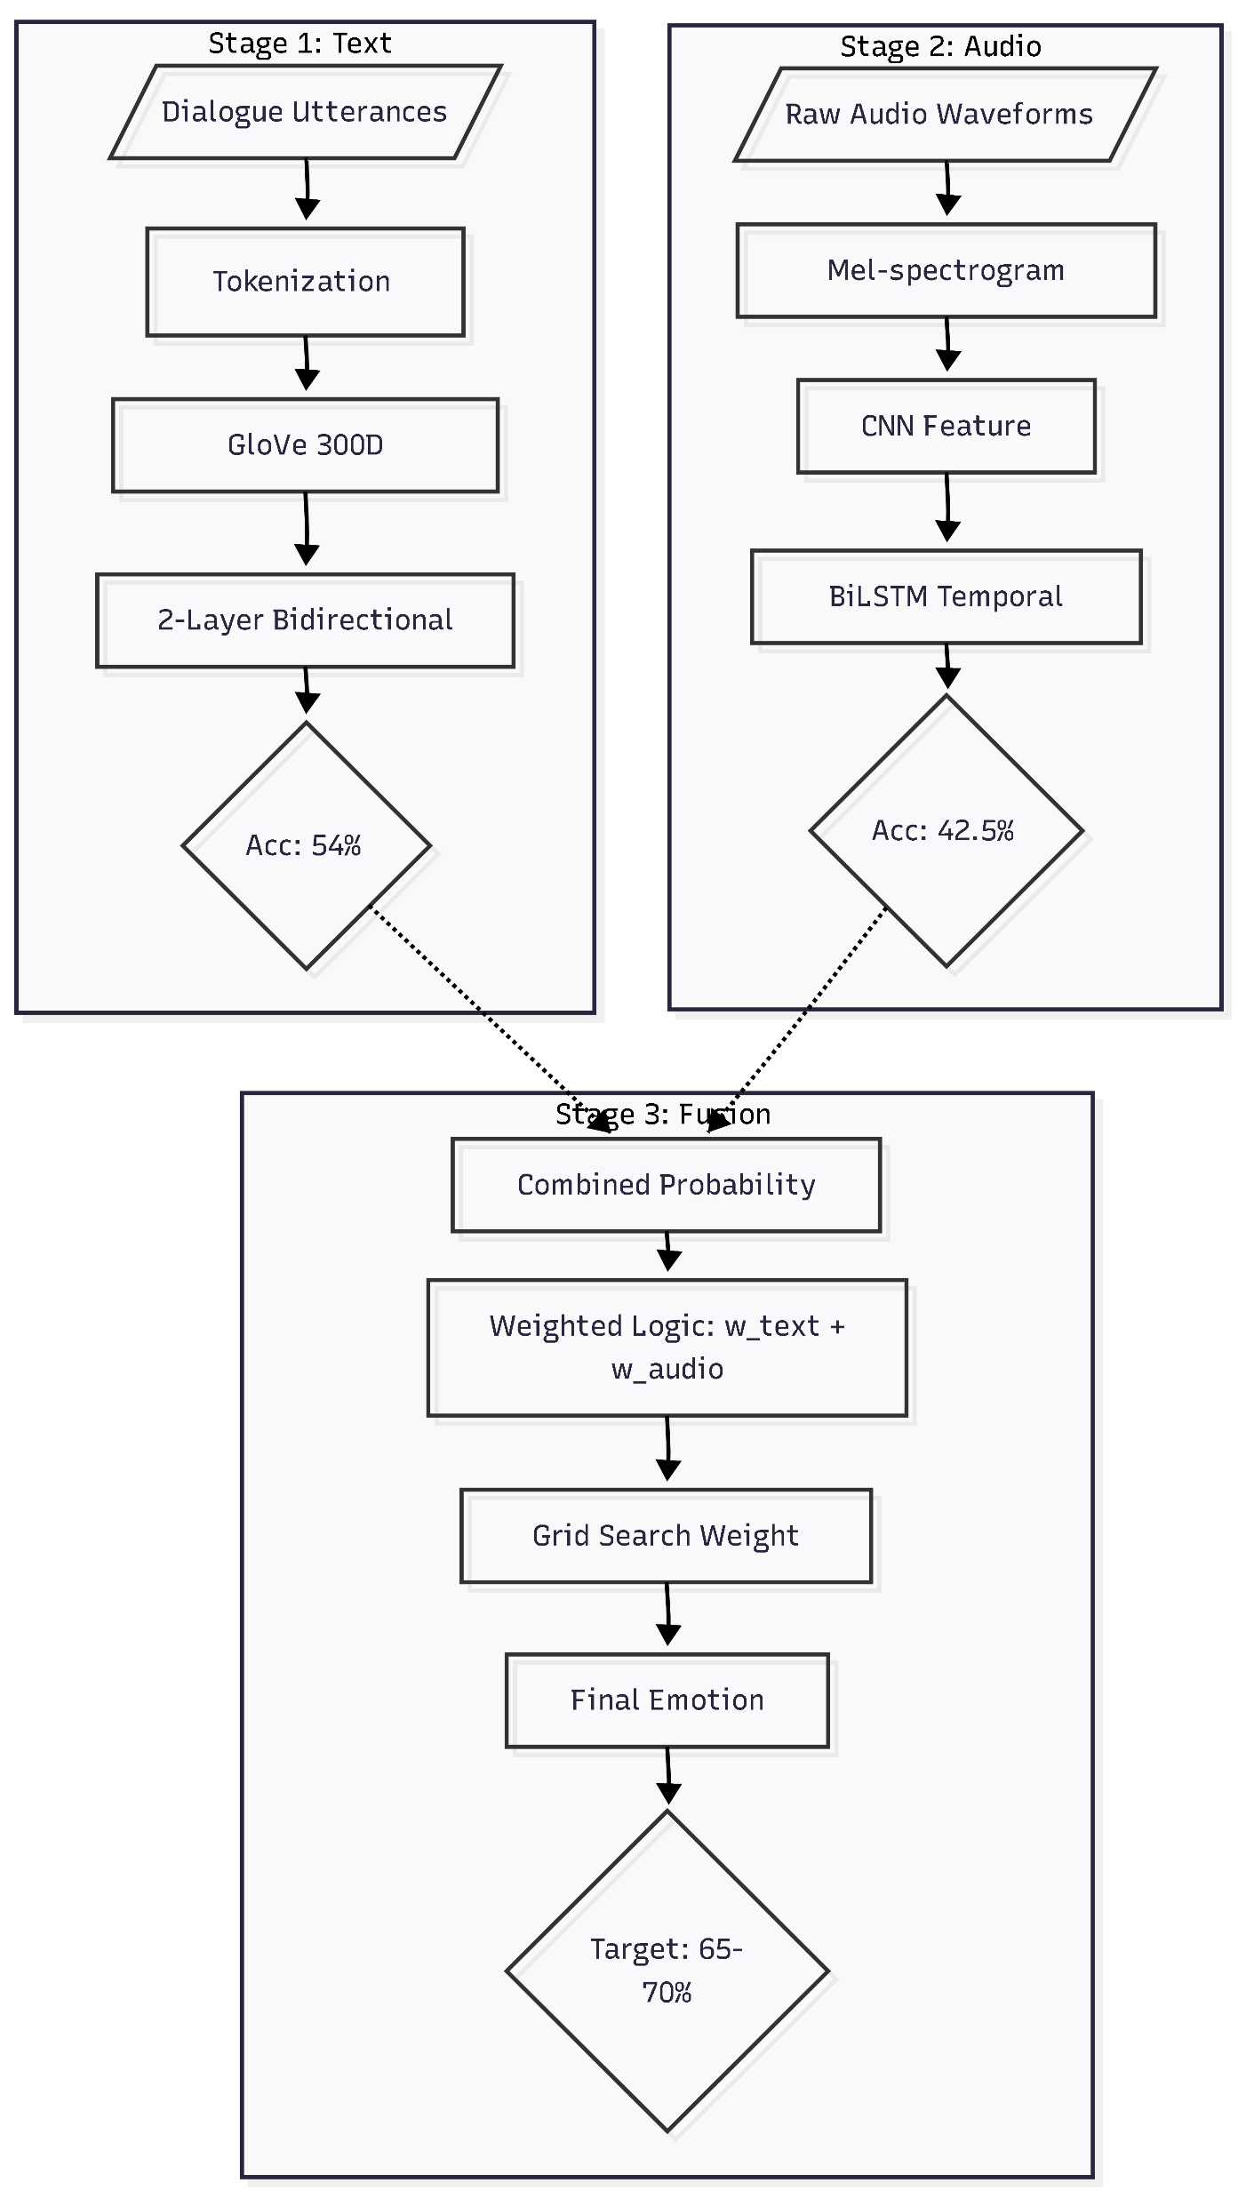

Slide 9
Architechture Overview:
1)Text Modality - LSTM Classifier
Input: Dialogue utterances (conversational text)
Processing: Tokenization → GloVe 300D Embeddings → LSTM layers
Architecture: 2-layer Bidirectional LSTM (128 units)
Output: Text-based emotion probabilities (7 classes)
Performance: 54% accuracy
2)Audio Modality - CNN-BiLSTM Classifier
Input: Raw audio waveforms from MELD conversations
Processing: Mel-spectrogram extraction → Hybrid CNN-BiLSTM
Architecture: CNN (spectral patterns) + BiLSTM (temporal dynamics)
Output: Audio-based emotion probabilities (7 classes)
Performance: 42.5% validation accuracy

Slide 10
Optimizer & Learning Rate:
Optimizer: Adam
Initial Learning Rate: 0.001 (optimal after tuning)
Regularization Strategy:
Strong Dropout: 0.5 across fully-connected layers
LSTM Dropout: 0.4 + 0.2 recurrent dropout
CNN Dropout: 0.3 after each conv block
BatchNormalization: After each major layer
Early Stopping: Patience=5, restore best weights
Training Hyperparameters:
Batch size: 32 (balanced memory/convergence)
Epochs: 30 (with early stopping)
Class weights: Initially tested, removed (too extreme for 28:1 imbalance)

Slide 11
3)Multimodal Fusion - Late Fusion
Strategy: Weighted combination of modality predictions
Method: combined_score = w_text × text_pred + w_audio × audio_pred
Weights: Learned via small neural layer or grid search
Expected Output: Enhanced emotion classification (65-70% target)

Slide 12
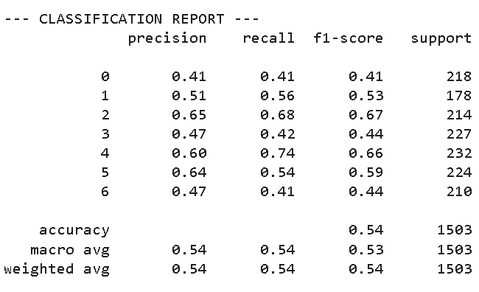
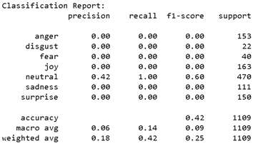
Result
Fig: Classification Report for Textual LSTM
Fig: Classification Report for Audio CNN-BiLSTM

Slide 13
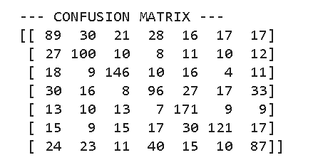
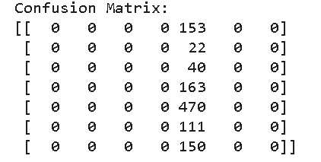
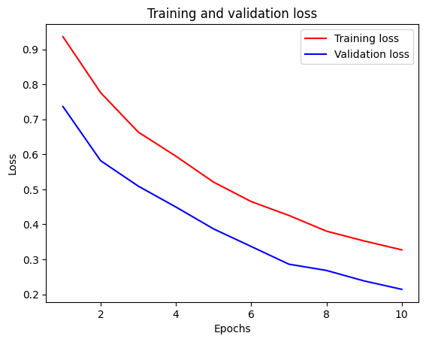
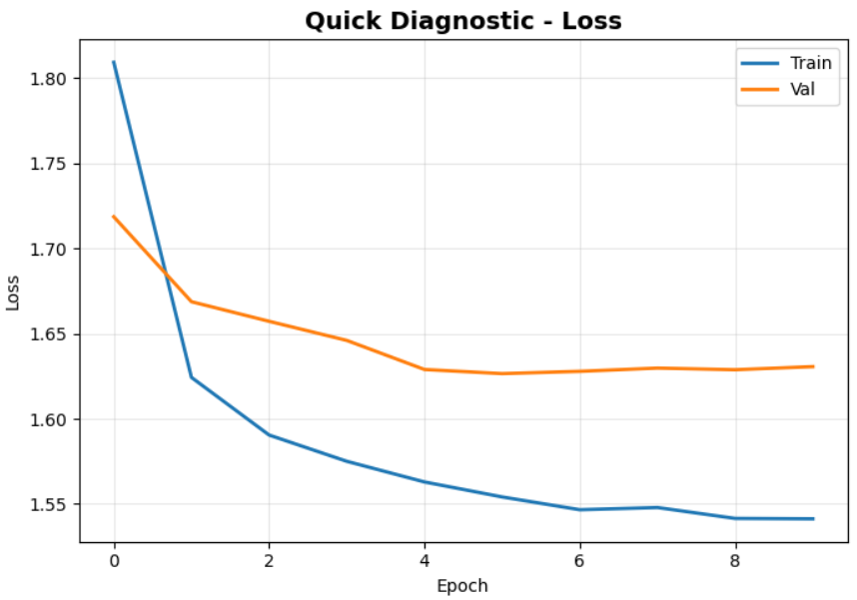
Fig
: Textual LSTM
Fig: Audio CNN-BiLSTM

Slide 14
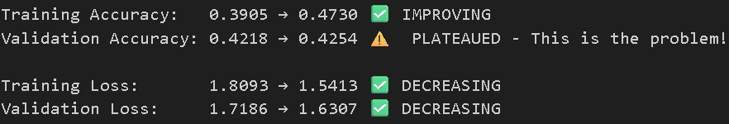
Audio Model Analysis
Key Observations:
Neutral dominates: 58% recall (most frequent class)
Minimal overfitting (gap reduced from 61% to 5%)
Minority struggle: Disgust (8% precision), Fear (6% precision)
Validation accuracy plateaus at ~42.5%
Performance ceiling due to inherent task difficulty

Slide 15
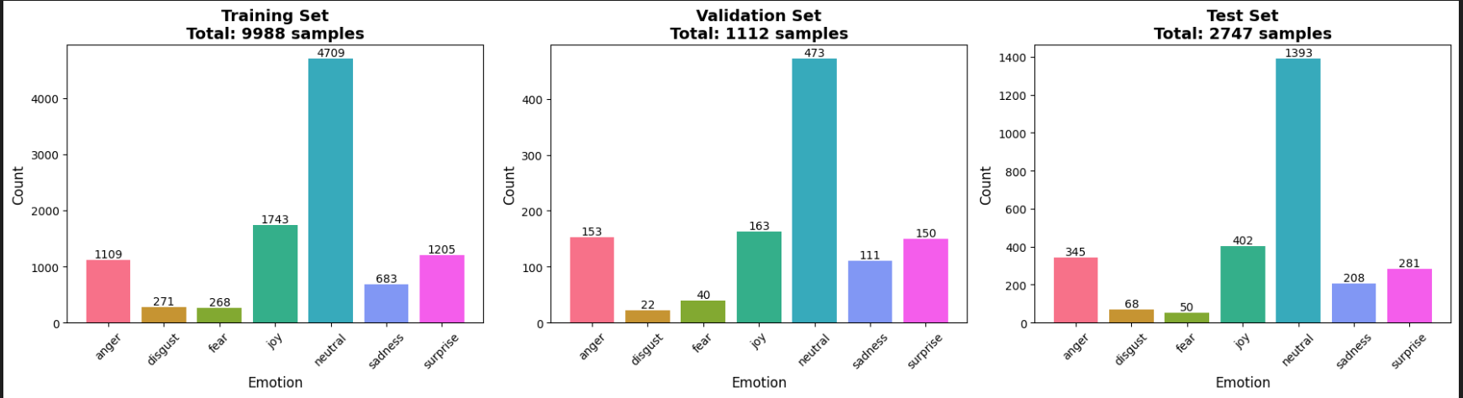
Reasons why accuracy plateaus at 42.5%
1) Severe Class Imbalance (Primary Factor)
Imbalance Ratio: 17.6:1 (Neutral vs Fear)
Neutral class: 47.15% of training data
Minority classes (Fear, Disgust): <3% each
Thus, Model biases toward majority class (neutral)

Slide 16
2) Limited Discriminative Power of Audio-Only Features
Audio alone insufficient for emotion recognition
Silhouette Score: 0.18 (poor class separation)
Davies-Bouldin Index: 2.4 (high cluster overlap)
Thus, features cannot distinguish between emotions effectively
3) Inherent Task Difficulty
Emotion in speech is subtle and context-dependent
Same words can convey different emotions based on context
Lack of visual/textual context limits understanding
State-of-the-art audio-only: 50-55% accuracy
Our result (42.5%): Within expected range for severe imbalance

Slide 17
Fine-tuning and Optimisation
Overfitting mitigation strategies were implemented as follows and optimal configuration was found to be strong dropout (0.5) without class weights with minimal overfitting.
Strategy | Configuration | Train Acc | Val Acc | Gap | Status
No Regularization | Baseline | 91.4% | 29.9% | 61.5% | Severe overfitting
Strong Dropout | 0.5 across layers | 47.3% | 42.5% | 4.8% | Optimal
Dropout + Class Weights | Balanced weights | 14.2% | 21.3% | -7.1% | Too extreme
Scaled Class Weights | 0.3× scaling | 38.5% | 39.2% | -0.7% | Under-learning
Low Dropout | 0.2-0.3 | 68.2% | 35.1% | 33.1% | Still overfitting
High Dropout | 0.6 | 32.4% | 38.7% | -6.3% | Under-fitting

Slide 18
Outcome
By next assessment, this project will deliver a fully integrated multimodal emotion recognition system on the MELD dataset. The key outcome will be a functional model that synergistically combines text and audio modalities using an advanced fusion technique, demonstrating a significant performance improvement over the current unimodal baselines and providing a robust foundation for a research publication.

Slide 19
References
[1] S. Poria, E. Cambria, R. Bajpai, and A. Hussain, "A Review of Affective Computing: From Unimodal Analysis to Multimodal Fusion," Information Fusion, vol. 37, pp. 98–125, 2017.
[2] S. Poria, D. Hazarika, N. Majumder, and R. Mihalcea, "MELD: A Multimodal Multi-Party Dataset for Emotion Recognition in Conversations," arXiv preprint arXiv:1902.00946, 2019.
[3] Z. Lian, B. Liu, and J. Tao, "CTNet: Conversational Transformer Network for Emotion Recognition," IEEE/ACM Transactions on Audio, Speech, and Language Processing, vol. 29, pp. 985-1000, 2021.
[4] S. Hochreiter and J. Schmidhuber, "Long short-term memory," Neural Computation, vol. 9, no. 8, pp. 1735–1780, 1997.
[5] J. Devlin, M.-W. Chang, K. Lee, and K. Toutanova, "BERT: Pre-training of Deep Bidirectional Transformers for Language Understanding," in Proceedings of NAACL-HLT, 2019, pp. 4171–4186.
[6] Z. Lian, B. Liu, and J. Tao, "SMN: Situated Multimodal Network for Emotion Recognition in Conversations," IEEE Transactions on Affective Computing, 2021.
[7] A. Satt, S. Rozenberg, and R. Hoory, "Efficient Emotion Recognition from Speech Using Deep Learning on Spectrograms," in Proceedings of Interspeech, Stockholm, Sweden, 2017, pp. 1089-1093.
[8] A. Mollahosseini, B. Hasani, and M. H. Mahoor, "AffectNet: A Database for Facial Expression, Valence, and Arousal Computing in the Wild," IEEE Transactions on Affective Computing, vol. 10, no. 1, pp. 18-31, Jan.-Mar. 2019.
[9] S. Yoon, S. Byun, S. Dey, and K. Jung, "Speech Emotion Recognition Using Multi-Hop Attention Mechanism," in ICASSP, 2023, pp. 1-5.
[10] F. Ma, B. Sun, and S. Li, "Facial Expression Recognition with Visual Transformers and Attentional Selective Fusion," IEEE Transactions on Affective Computing, 2022.

Slide 20
Thank You

